Slide 1

Helping Goalkeepers
Deal With Mistakes
Chris Smith, Terry Moss, Jordan Welsh

Slide 2
Challenging GK Perspectives
-Recognising Necessary Mistakes
-Understanding the role of mistakes in a goalkeeper’s development

Slide 3
Preparing for Mistakes
-Rehearsing mistakes & our reactions in training environment
-Providing tools such as event chunking for goalkeepers to manage headspace through a match

Slide 4
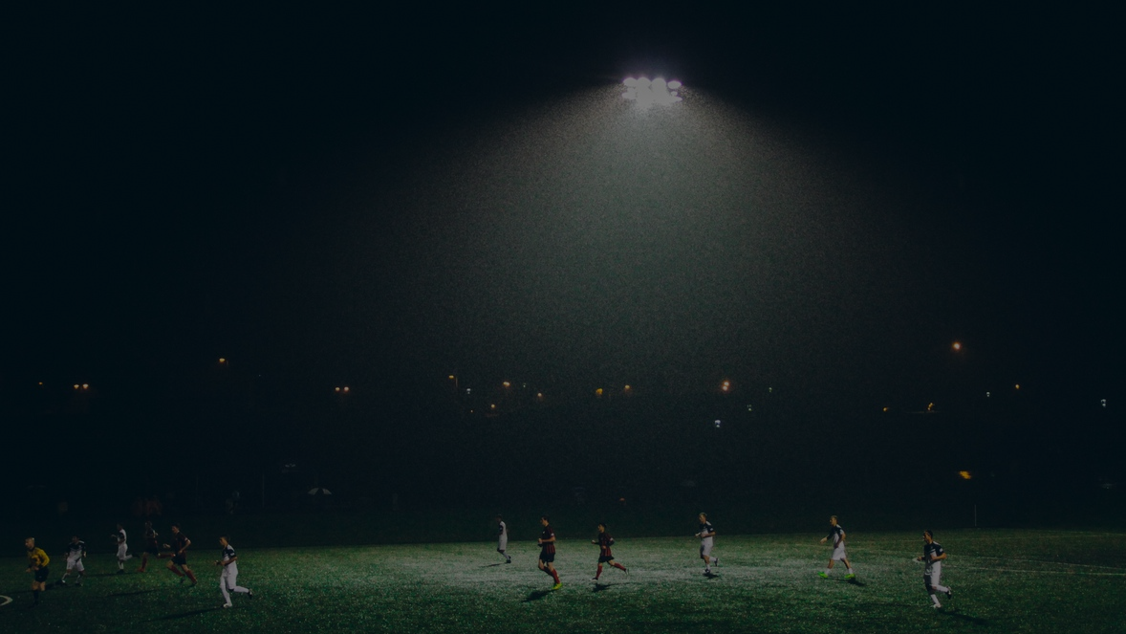
Mistake: A Timeline for Goalkeepers
#1 Mistake Happens.
#2 Goalkeeper feels the mistake.
#3 Emotional response to the mistake (angry, sad, embarrassed, etc).
#4 Teammates, coaches, spectators will possibly voice their opinion of the mistake toward the goalkeeper.
#5 Goalkeeper chooses to ignore or internalize the opinions of teammates, coaches, or spectators.
#6 Discussion with GK Coach about the mistake.
#7 Training Session after the mistake.

Slide 5
How Does the Goalkeeper React to the Mistake?
Goalkeeper can choose to exhibit Mental Strength in dealing with the mistake. GK can put the mistake away for now and focus on the game at hand.
OR
Goalkeeper will let the mistake lead to self doubt and more mistakes may creep into the game. GK is unable to put the mistake away until a later opportunity.

Slide 6
Goalkeeper Coach and Goalkeeper
-GK Coach and GK communicate about the mistake.
-This can be a quick word at halftime and/or a more in-depth discussion post match.
-Thoughts, opinions, positioning, decision making, other factors should be discussed and put in the open.
-From this conversation the goalkeeper coach can design a training session to address and correct the mistake.

Slide 7
Training Session After Mistake
New day. Training Session built upon prior discussion.
Progression work with predictable and unpredictable outcomes tailored to the mistake that was previously made.
Repetition will build Consistency.
Consistency will build Confidence.
Confidence will build Success!

Slide 8
Next Match Day
The Work has been done.
Bring Confidence to the Game.
Trust Yourself.
Perform!
Execute your skills with Confidence and Consistency to achieve Success!

Slide 9
Question Time

